Slide 1
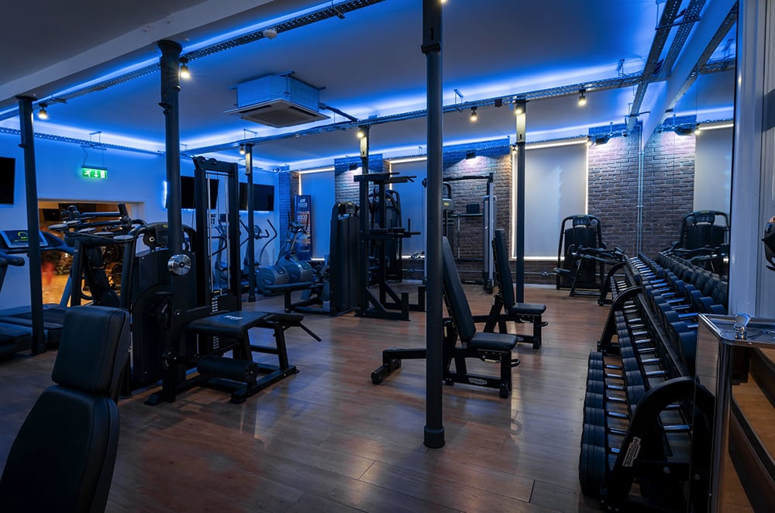
GYM MANAGEMENT SYSTEM
LRG GOVERNMENT ARTS COLLEGE FOR WOMENS
NAME : M.ABINAYA
CLASS: III B.SC COMPUTER SCIENCE
UNDER THE GUIDENCE: Dr.KOHILA

Slide 2
ABSTRACT
This project “Gym Management System” is solution fitness centers to manage the customers in an easier and more convenient way.
The administrator, is able to view all the members of fitness center as well as their details.
This project is a computer-based program and it manages the gym members, the personnel and the inventory.
Also maintain the gym members in and out details it will automatically calculate the member workout timings.
This system also has to display the material details and the quantity.

Slide 3
HARDWARE SPECFICATION
Processor : P 4 700 GHz.
RAM : 4 GB RAM
Hard Disk Drive : 180 GB

Slide 4
SOFTWARE SPECIFICATION
Operating System : Windows 7/8/10
Front End : JAVA
Back End : SQL

Slide 5
EXISTING SYSTEM
The gym is working manually. The current system is time consuming and also it is very costly, because it involves a lot of paperwork. To manually handle the system was very difficult task. But now-a-days computerization made easy to work.
Disadvantages:
The following are the reasons why the current system should be computerized:
To increase efficiency with reduced cost.
To reduce the burden of paper work
To save time management for recording details of each and every member and employee.
To generate required reports easily

Slide 6
PROPOSED SYSTEM
This Gym Management System tool is basically developed to aid the user to add a member to the gym.
The user shall be able to add the name, date of birth and contact address of the member.
It also records the phone numbers and the height and weight data of the member.
It also has an option to check whether the member is new or an existing one. It shall also enable the user to update information of members.
This tool uses .NET framework with MS Access as the database. It secures the data of each user.
Storage and retrieval of data is fast through these .NET tools System.

Slide 7
Advantages
It provides wide range of certain criteria in each window the client is working for better and quicker solution.
It maintains report for all criteria and transactions.
Manages member information separately for all exercise and employee information separately for considering the requirements of gym.
Stores information about regular products.
This system can run on any windows operating system

Slide 8
MODULES
Member Registration
IN/OUT Entry Details
GYM Materials
Service Entries
Health tips

Slide 9
MEMBER REGISTRATION:
This module will be used to perform get the data about the gym members. This detail will be stored in a database. When the gym owner needs an details for the members it will takes from the member table.

Slide 10
IN/OUT ENTRY
This module has been collecting the in time and out time information for the members. This will give and entire report about the members. We can easy to track the working hours for the members.

Slide 11
GYM MATERIAL
This module will used to store the information about the gym material, which can collect all the information and store into the material table.

Slide 12
SERVICE ENTRIES
This module will store the information for the services issues, gym owner any time can check the services in the service table.

Slide 13
HEALTH TIPS
This contains collect the information regarding the health tips, the gym workers easily to find out the tips and helps to the workers.

Slide 14
DATA FLOW DIAGRAM
LEVEL 0:
Gym
management
system
user name
Trainer
password

Slide 15
LEVEL 1:
Login
Member
Registration
Member
In/Out Entry
In/Out
Gym
Material
Material
Service
Entry
Service
Health
Tips
Health

Slide 16
TABLE NAME:ADMIN
FIELD | DATA TYPE | SIZE | CONSTRAINT
Admin id | int | 10 | Primary key
Admin name | varchar | 20 | Not null
Admin mobile | int | 10 | Not null
User name | varchar | 20 | Not null
password | varchar | 20 | Not null
address | varchar | 30 | Not null

Slide 17
TABLE NAME:MEMBER
FIELD | DATA TYPE | SIZE | CONSTRAINT
Member id | Int | 10 | Primary key
First name | Varchar | 20 | Not null
Last name | Varchar | 10 | Not null
Mobile | Int | 10 | Not null
Email | Varchar | 20 | Not null
Age | Int | 10 | Not null
Gender | Varchar | 5 | Not null
Height | Int | 5 | Not null
Weight | Int | 5 | Not null
Address | Varchar | 30 | Not null

Slide 18
TABLE NAME:IN/OUTPUT
FIELD | DATA TYPE | SIZE | CONSTRAINT
In out id | Int | 10 | Primary key
Member id | Int | 10 | Foreign key
Punch in | Date | 10 | Not null
Punch out | Date | 10 | Not null
date | Date | 10 | Not null

Slide 19
TABLE NAME:MATERIAL
FIELD | DATA TYPE | SIZE | CONSTRAINT
Material id | Int | 10 | Primary key
Material name | Varchar | 30 | Not null
Quantity | Int | 6 | Not null
amount | Int | 5 | Not null

Slide 20
TABLE NAME:SERVICE
FIELD | DATA TYPE | SIZE | CONSTRAINT
Service id | Int | 10 | Primary key
Material name | Varchar | 20 | Not null
Provider | Varchar | 20 | Not null
Amount | Int | 5 | Not null
Issue | Varchar | 30 | Not null
date | Date | 10 | Not null

Slide 21
TABLE NAME:HEALTH
FIELD | DATA TYPE | SIZE | CONSTRAINT
Health id | Int | 10 | Primary key
Health title | Varchar | 20 | Not null
Description | Varchar | 30 | Not null
date | Date | 10 | Not null

Slide 22
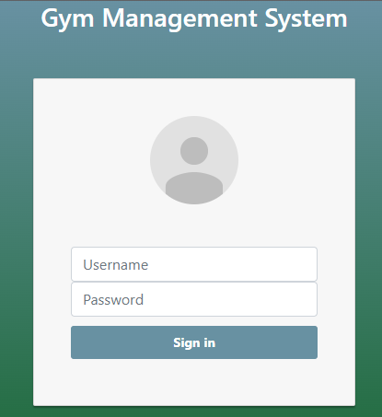
FORM DESIGN

Slide 23
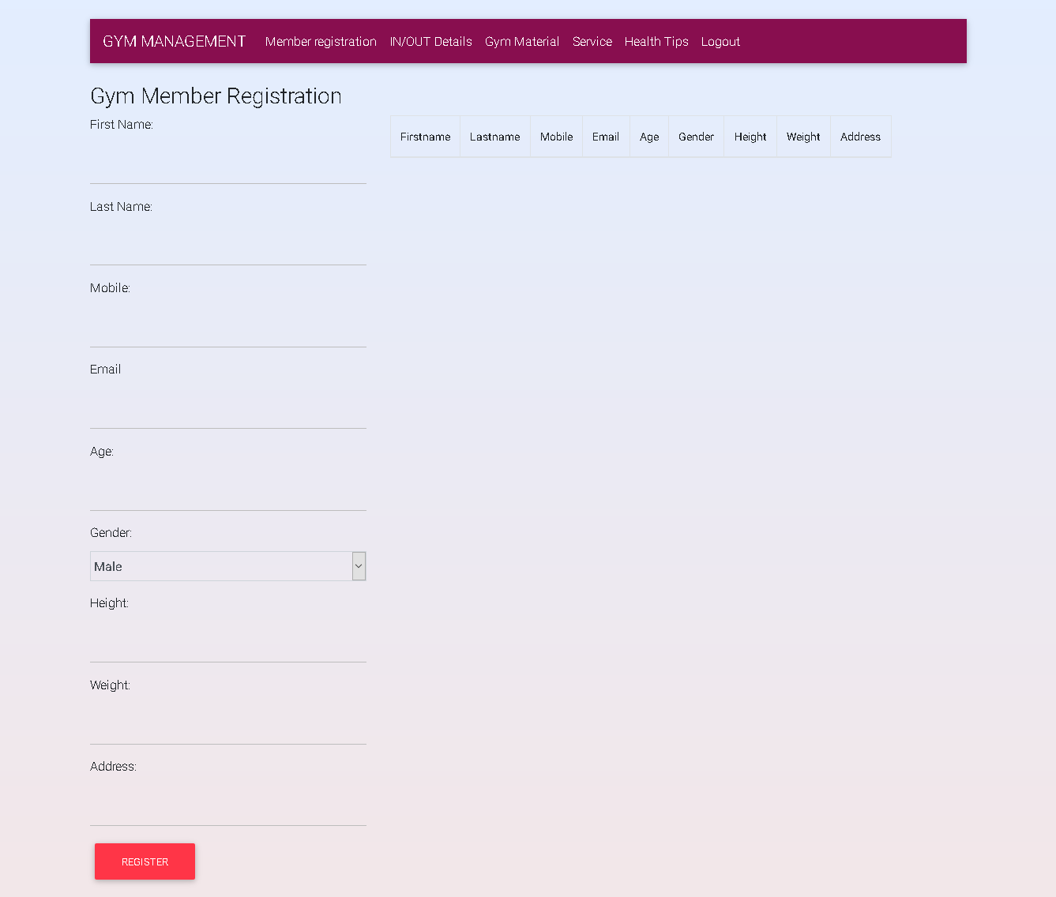

Slide 24
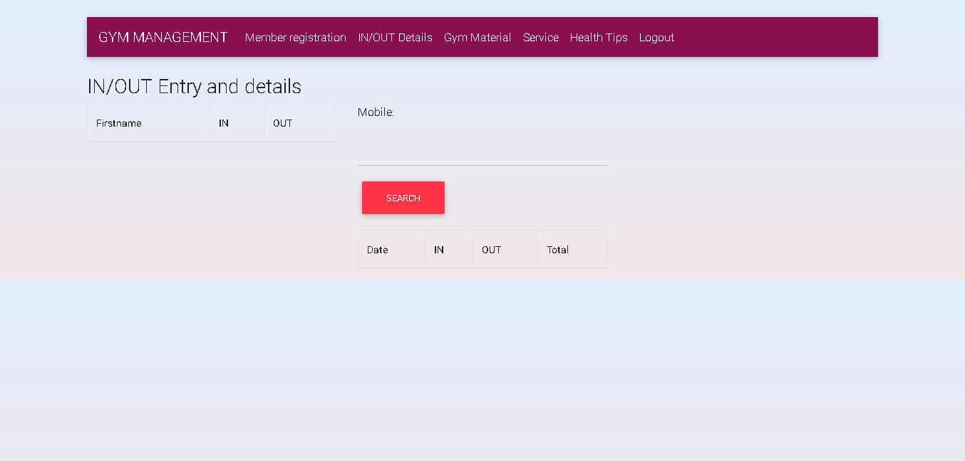

Slide 25
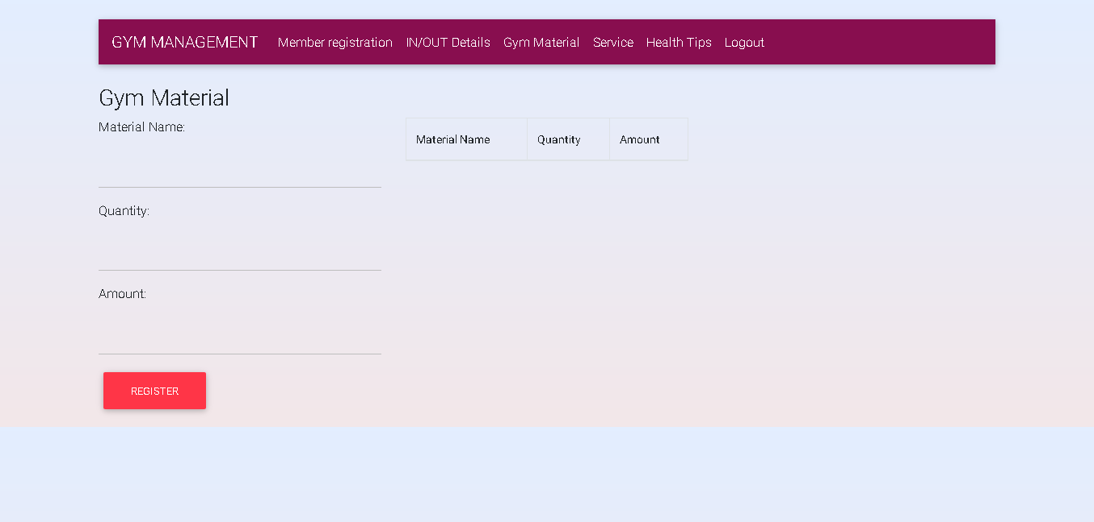

Slide 26
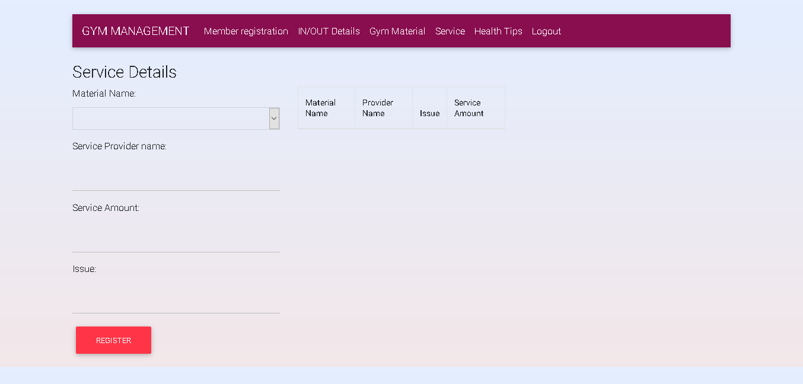

Slide 27
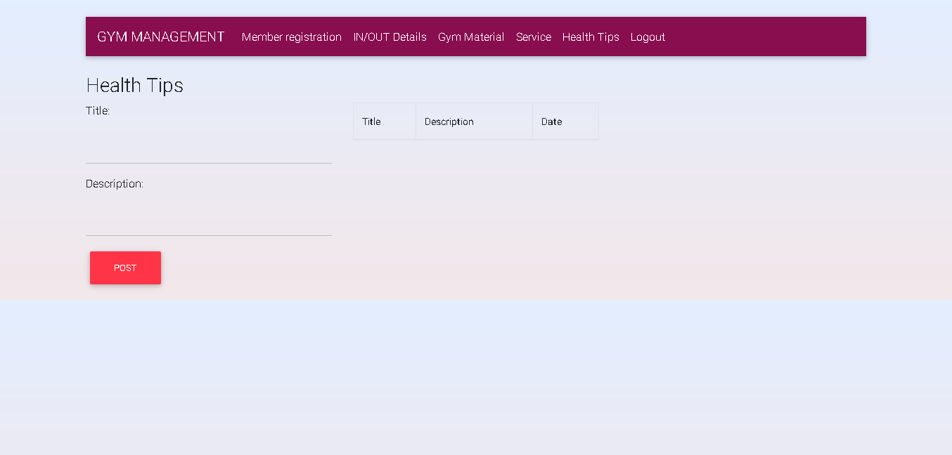

Slide 28
Thank you

